Slide 1
Climate system modeling and some methods diagnostic of midlatitude extreme weather in Northern Hemisphere
G. Platov^{1,2} , , V. Gradov², I. Borovko¹, E. Volodin⁴, V. Krupchatnikov^{1,2,3}
¹ Institute computational mathematics and mathematical geophysics SB RAS
² Novosibirsk State University
³ SibNIGMI RosHydroMet
⁴ Marchuk Institute of numerical mathematics RAS
Email: vkrupchatnikov@yandex.ru
Научно-практическая конференция по проблемам
Гидрометеорологических прогнозов, экологии, климата Сибири
(к 50-летию образования ФГБУ «СибНИГМИ»)
20-22 октября 2021 г.

Slide 2
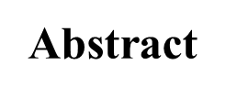
CONTENT
1. Introduction
2. Methods
2.1. Theory Wave Activity
2.2. Local Wave Activity
2.3. Blocking event index
3. Model and Experiments
4. Results
4.1. Reduction of the ice volume and its area
4.2. Anomalies of the zonal distribution potential temperature
4.3. Wave activity and blockings
5. Conclusions

Slide 3
Abstract
Recent decades have seen accentuated warming and precipitous decline of sea ice in the Arctic, in keeping with the so-called Arctic amplification anticipated from the increasing greenhouse gas forcing.
Accompanying the Arctic change are the more frequently observed weather extremes in the Northern Hemisphere midlatitudes. Locations for the occurrence of weather extremes and their trends and a better understanding of their regional impact on weather is importance. Circulation pattern that can lead to such extremes, the blocking event, is a synoptic-scale phenomenon that blocks the jet stream, resulting in persistent weather. Atmospheric blocking has received attention for many decades and is still very much a topic of actuality because of its relationship to extreme weather.
This research was funded by Russian Science Foundation grant number 19-17-00154.

Slide 4
1. Introduction
Since the mid-20th century, the Arctic is experiencing an entire shift in its ecosystem and environment with plenty of significant impacts including those associated with climate change: warming faster than average global warming and reducing winter and summer sea ice cover. However, the effect of melting sea ice in the Arctic on the global climate remains a matter of debate.
In the Arctic, the ice-albedo feedback mechanism plays a key role in the balance of heat and ice mass at the ocean surface.
In this work, a series of numerical experiments is considered to identify the direct role of the sea ice reduction process in forming climatic trends in the northern hemisphere. We will use two more or less independent mechanisms for reducing ice in our numerical simulations. We assume that comparing the results of these experiments with different mechanisms of ice reduction will make it possible to judge the direct role of ice reduction regardless of the reasons that caused this reduction. We will consider the sensitivity of atmospheric blocking and wave activity in mid-latitudes to Arctic ice variations.

Slide 5
2. Methods
2.1. Theory Wave Activity
The energy approach is a useful basis for describing the interaction of vortices and mean flow and provides a simple physical interpretation, however, the perturbation energy is not conserved during the interaction of the mean flow of vortices due to the possibility of energy exchange between waves and mean flow (eddies grow with instability, for example, baroclinic instability)
Therefore, a different approach to the description of this phenomenon was required, which was done by Eliassen and Palma in 1961. They introduced a new concept, namely, wave activity, which is preserved in the absence of forcing and dissipation, and serves as a generalization of the energy of vortices (EKE), since it combine vortex dynamics and dynamics of the average flow in one quantity.

Slide 6
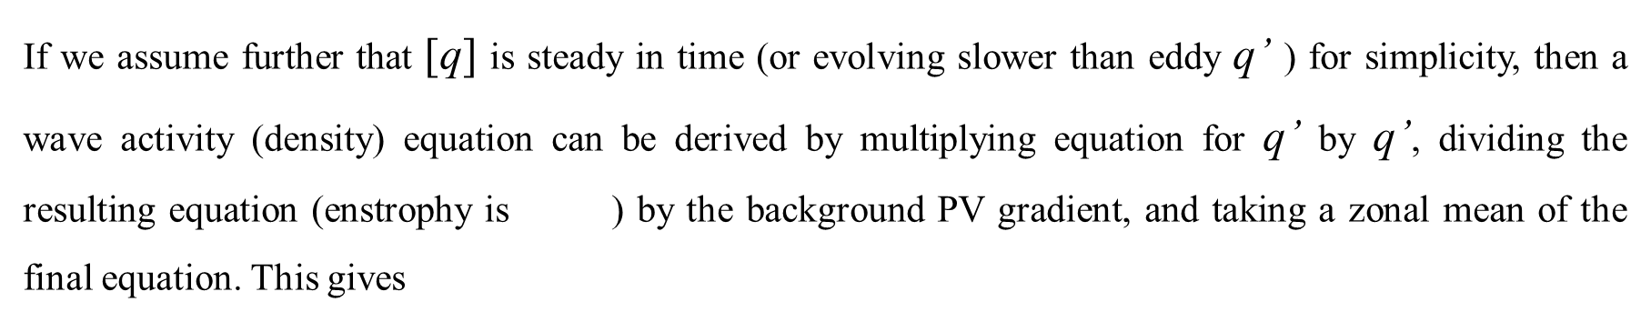
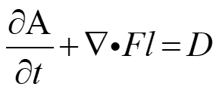
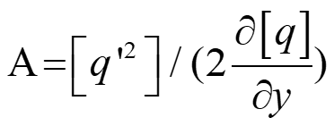
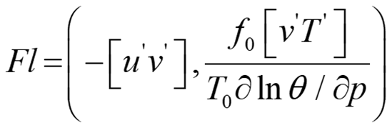
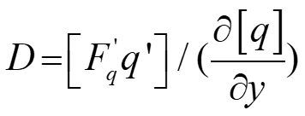
A description of the theory of wave activity (WA) usually starts with the potential vortex (PV) equation. For simplicity, the theory of wave activity is described using the low-amplitude wave approximation and quasi-geostrophic theory.
where

Slide 7
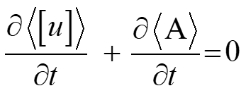
In order to find the eddy influence on the mean ow (and vice versa), Andrews and McIntyre (1976) derived the so-called transformed Eulerian mean (TEM) system of equations, which linked the EP flux divergence to the zonal momentum equation (using vertically averaged eq. for A), yielding (after simplifications)
In the absence of forcing and dissipation then reduces to
(***)
which means that if wave activity increases in some part of the domain, the zonal mean wind
must decrease there, and vice versa (which is also referred to as the non-acceleration theorem)

Slide 8
The nonacceleration relation (***) shows conservation of the sum of zonal-mean zonal wind and wave activity in a frictionless barotropic flow, but it does not tell whether the deceleration of the zonal-mean wind is because of growth of a localized wave packet or simultaneous growth of multiple wave packets over longitudes.
To understand the dynamics of a localized phenomenon such as blocking, it is desirable to characterize eddy–mean flow interaction over a regional scale.
The best diagnostics for the interaction of vortices and mean flow is wave activity, a measure of the momentum carried by vortices. Wave activity of finite-amplitude was proposed as an objective measure for the spatial variation of a physical quantity, demonstrating monotonicity in the spatial distribution. Finite-amplitude wave activity (FAWA) is a generalization of the linear wave activity of small amplitude waves. FAWA (denoted as A) is defined as the area formed when the quasi-geostrophic potential vorticity (QG PV) contour q is displaced from its zonally symmetric state

Slide 9
FAWA (denoted as A*) is defined as the area formed when the quasi-geostrophic potential vorticity (QGPV) contour q is displaced from its zonally symmetric state
From (S. W. Lubis et al., 2018; G. Platov et al., 2021)
where a is the radius of the planet, q is QG PV, Q(φe) is PV with respect to equivalent latitude on each z surface, and dS = a**(2) cosφ dλdφ is the area element

Slide 10
The tendency of A* satisfies an Eliassen–Palm (EP) relation
The changes in S can be accounted for by the changes in effective diffusivity of the irreversible mixing of PV across its contour Diffeff and changes in the sources and sinks of wave activity as a result of diabatic heating and cooling averaged over the displaced area of PV ( ). When the terms on the right-hand side of Eq. are zero, it takes the form of a conservation law for wave activity.

Slide 11
2.2. Local Wave Activity
FAWA is a zonally averaged quantity and is incapable of distinguishing longitudinally isolated events, such as atmospheric blocking. To eliminate this disadvantage, a local wave activity (LWA) of a finite amplitude is introduced (Huang and Nakamura, 2016). LWA is an extension of finite amplitude wave activity as a function of longitude, which measures the net ‘‘exchange’’ of PV substance across latitude circles. In spherical coordinates, LWA is defined as

Slide 12
Local nonacceleration relation
If the atmospheric wave packets such that the wavelength is much smaller than the length scale of the packet, by choosing Δx to be the wavelength, the right-hand side of (****) would be a small residual because of the slow modulation of wave properties in x. Thus, on short time scales
(****)
If define LWA as

Slide 13
2.3. Blocking event index
Blocking events are generally associated with persistent high-pressure systems that interrupt the prevailing westerly winds of middle and high latitudes, thus hindering the normal eastward propagation of extratropical weather systems.
Persistent episodes of extreme weather in the Northern Hemisphere (NH) have been shown to be associated with high-amplitude quasi-stationary atmospheric Rossby waves, disrupting the passage of the transient waves (Nakamura and Huang 2018; Woollings et al. 2010).
In the NH, blocking events are frequent at the exit zones of the jet stream, as for example over the northeastern North Atlantic and the eastern Pacific regions (see Barriopedro et al., 2006; Nakamura and Huang, 2018). The frequency of blocking events varies seasonally with a maximum in winter-spring, and a minimum in summer-fall (Parsons et al., 2016; Trenberth and Mo, 1985; etc.)
Also a strong relationship was found between North Atlantic blocking events and North Atlantic Oscillation (NAO), Atlantic Multidecadal Oscillation (AMO)

Slide 14
Some theoretical studies of blocking events
Theoretical studies of blocking began in the 1940s. For example, (Namias, J. & P.F. Clapp. 1944) examined the propagation speed and development of upper troposphere long waves and used the Rossby wave equation in order to verify that long waves obeyed this relationship. They noted that blocking could be described as disturbances that were either stationary or moved slowly westward and whose dimensions were consistent with those suggested by the Rossby formula.
Then, Rossby himself described blocking action as group velocity convergence in long quasistationary waves, in which the zonal flow weakened, resulting in an increase in meridional energy.
He defined the meridional energy as proportional to vorticity, and called this quantity intensity as well. This suggests the action of shorter waves supported blocking events.

Slide 15
In review (Anthony R. Lupo, 2020) presents highlights of the history of blocking research over the past several decades to provide insight to the broader scientific community.
Blocking events to occur primarily over the oceans. In spite of the tendency to occur over the oceans, blocking often impacts large population centers because of their vast size and the fact that they persist for about 8–10 days. Even thought anticyclones are thought often to be stationary phenomena, they can be associated with extreme weather conditions.
While blocking anticyclones tend to be associated with cloud-free conditions, many studies have associated blocking with anomalous weather over the regions they exist in, as well as the upstream and downstream regions, because of their impact on the jet stream. Episodes of frequent blocking have been associated with such events as heat waves and droughts since the 1970s for mid- and high-latitude locations -->>
Obukhov, A.M., M.V. Kurgansky & M.S. Tatarskaya., 1984; Agayan, G.M. & I.I. Mokhov. 1989; Lupo, A.R., I.I. Mokhov, M.G. Akperov, et al. 2012; Semenova, I.G. 2012; Voropay, N.N. & A.A. Ryazanova. 2018, etc.

Slide 16
Examples of blocking anticyclones on a 500-hPa height map for (A) 1200 26 February 2019 (omega block, Pacific region), (B) 1200 UTC 3 September 2019 (dipole block), and (C) 1200 UTC 9 November 2019 (Rex block). Panels A and C are from the Northern Hemisphere, while panel B is from the Southern Hemisphere. Atmospheric blocking events are marked with
a Greek omega over an H. The contour interval is 60 meters.

Slide 17
The frequency of block occurrence (ordinate) versus longitude (abscissa) for the (A) Northern Hemisphere and (B) Southern Hemisphere. (Lupo, A.R., A.D. Jensen, I.I. Mokhov, et al. 2019)

Slide 18
The interaction of the mean flow and vortices, which leads to the anomalous state of the mid-latitude jet, is associated with propagating and breaking waves in the upper troposphere and stratosphere. Extreme weather events in extratropical latitudes are usually associated with blocking anticyclones. We used the blocking diagnostics proposed by Tibaldi and Molteni (TM) in [*] and further developed in [**]
They proposed to use the southern and northern gradients of the geopotential height (GHGS and GHGN). For each point with coordinates λ and φ , two indices could be determined as follows:
where Gm is taken to be equal to -5 m/(degree of latitude)
*. Tibaldi, S.; Molteni, F. On the Operational Predictability of Blocking. Tellus 1990, 42A, 343–365. doi: 10.3402/tellusa.v42i3.11882
**. Scherrer, S.; Croci-Maspoli, M.; Schwierz, C.; Appenzeller, C. Two-dimensional indices of atmospheric blocking and their statistical relationship with winter climate patterns in the Euro-Atlantic region. Int. J. Climatol. 2006, 26, 233-249. doi: 10.1002/joc.1250

Slide 19
J. PELLY AND B. HOSKINS A New Perspective on Blocking, 2003
Authors argued that the essential aspect of atmospheric blocking may be seen in the wave breaking (WB) of potential temperature (θ) on a potential vorticity (PV) surface, which may be identified with the tropopause, and the consequent reversal of the usual meridional temperature gradient of θ.
A new dynamical blocking index is constructed using a meridional θ difference on a PV surface
The PV– θ index results for the annual average location of Pacific blocking agree with synoptic studies but disagree with modern quantitative height field–based studies. It is considered that the index used here is to be preferred anyway because of its dynamical basis. However, the longitudinal discrepancy is found to be associated with the use in the height field index studies of a central blocking latitude that is independent of longitude. In particular, the use in the North Pacific of a latitude that is suitable for the eastern North Atlantic leads to spurious categorization of blocking there. Furthermore, the PV– θ index is better able to detect Ω blocking than conventional height field indices

Slide 20
PV– θ index
A schematic representation of the relevant parameters for calculating the PV–θ blocking index B at a given longitude λ0. The thick line is a representative u on PV = 2 contour during a blocking event centered at λ0 in this case.

Slide 21
Quasi-stationary atmospheric circulation regimes drew attention of meteorologists long ago. In large number of publications have been devoted to an investigation of the so-called blocking-type regime: an investigation of its formation, statistical processing of data on the duration of existence of blockings of various types, a study of predictability of these regimes by using modern global models of the general atmospheric circulation, etc. These investigations showed that the regimes with blockings in model experiments were in a sense close to the stationary solutions to the problem which are generally unstable; therefore, the lifetime of such a solution actually depends on the form of the trajectory in which the movement takes place in the phase volume in the neighborhood of this stationary solution .

Slide 22
Instability indices for quasi-stationary atmospheric circulation regimes
V. Dymnikov (1990)
The paper formulates the notion of instability indices for quasi-stationary atmospheric circulation regimes. The regimes analyzed are assumed to be quasi-barotropic, and they can thus be described with a sufficient accuracy by vorticity barotropic equations. Sufficient conditions are formulated for the stability of stationary solutions to these equations with dissipation and stationary sources available. Instability indices for real quasi-stationary atmospheric circulation regimes are shown to be related to their lifetime.
Modes with blocking are in a sense close to stationary solutions of the problem, which are generally unstable; Consequently, the lifetime of such a solution actually depends on the shape of the trajectory along which the motion occurs in the phase volume in the vicinity of this stationary solution (B. Legras and M. Ghil, P., 1985)
Hypothesis
In this article, this statement is taken as a working hypothesis, i.e. it is assumed that quasi-stationary modes of atmospheric circulation arise when the trajectory of the system in phase space lies in the vicinity of an unstable stationary solution. Consequently, the task is to construct a (probabilistic) characteristic of the lifetime of such a quasi-stationary regime

Slide 23
On the problem of subtropical anticyclone regeneration as a factor of its stabilization (Case study for the summer of 2010)
E. K. Semenov, N. N. Sokolikhina, K. O. Tudrii
Published 2012 Russian Meteorology and Hydrology
The detailed investigation of conditions of the durational stabilization of subtropical anticyclone in the unusual region of the temperate zone is carried out and the reasons for its multiple regeneration are revealed. Separated are five periods of the subtropical anticyclone regeneration associated with the entering of active and relatively anticyclones of middle and high latitudes developed at the rear of cyclonic series into its circulation. All invasions were divided into three types depending on the trajectories of the movement of active anticyclones: the polar invasion from the north and northwest, the invasion from the east and northeast, and the western invasion from the Atlantic Ocean and Baltic Sea. The instability index introduced by V.P. Dymnikov was used for the quantitative estimation of the blocking process lifetime. It is demonstrated that this index is informative enough and could be used for the lifetime forecast of concrete quasistationary regimes of atmospheric circulation.

Slide 24
A new mathematical framework for atmospheric blocking events
V. Lucarini and A. Gritsun (2020)
Using finite-time Lyapunov exponents, authors of article show that the occurrence of blockings is associated with conditions featuring anomalously high instability and blockings are realized when the trajectory of the system is in the neighborhood of a specific class of unstable periodic orbits (UPOs), natural modes of variability that cover the attractor the system.
Despite many years of continuous progresses, numerical weather prediction systems have a comparatively low skill in predicting the onset and decay of blockings, and state-of-the-art climate models have a comparatively hard time in providing a statistics of blockings in terms of temporal prevalence and geographical location that fits well with observations. The understanding of how climate change will impact the statistics and dynamics of blocking events is far from being settled.
Remark: A rather different point of view, building upon the differences between the Atlantic and Pacific blockings, focuses on understanding the local causes for blockings, interpreted as forced structures resulting from eddy forcings (Haines and Marshall 1987) or from Rossby wave breaking (Pelly and Hoskins 2003), rather than actual stationary states

Slide 25
3. Model and Experiments
The study used the INM-CM48 climate system model (Volodin, E.M. et al., 2018), developed at the INM RAS and taking into account (using explicit modeling or parameterization) many mechanisms that determine climate change. The model can reproduce the dynamics of the atmosphere, sea ice, ocean, vegetation, and soils, taking into account greenhouse gases. The model resolution used in our study in the atmospheric and aerosol modules is 2.0̊ x 1.5̊ in longitude and latitude and 21 vertical levels. The upper bound in the atmospheric model is about 10 hPa.
Snow or ice albedo A is prescribed as A = Am in the case of melting ice or snow, A = Af in the case of surface temperature Ts < Tf , where Tf =263.15 K and

Slide 26
Table 1. Time-table and specifications of numerical experiments
global warming scenarios RCP2.6 and RCP4.5.

Slide 27
4. Results
We divide the result of numerical experiments into the three most essential parts.
The first part intentionally demonstrates how the Arctic ice volume and its area changed depending on the experimental conditions.
The second part demonstrates the changes in the zonal distribution of potential temperature and zonal velocity values with height.
The third part is associated with a change in the frequency of blocking situations in the atmospheric circulation and its connection with ice changes.

Slide 28
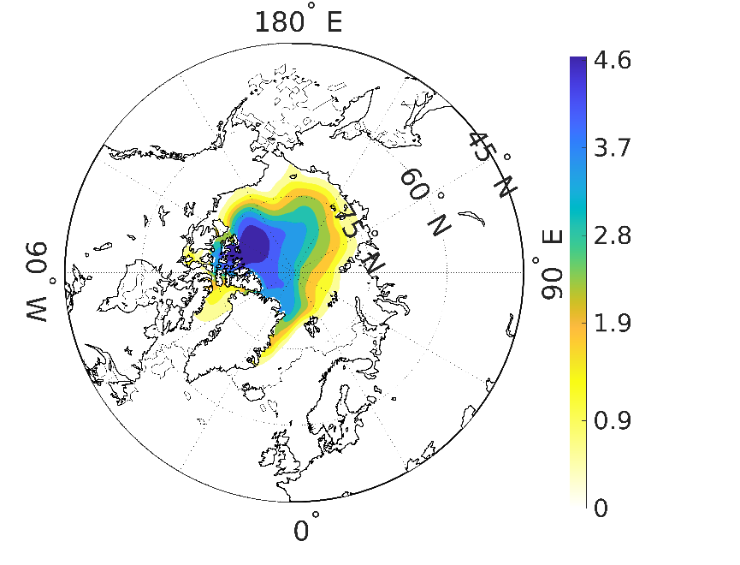
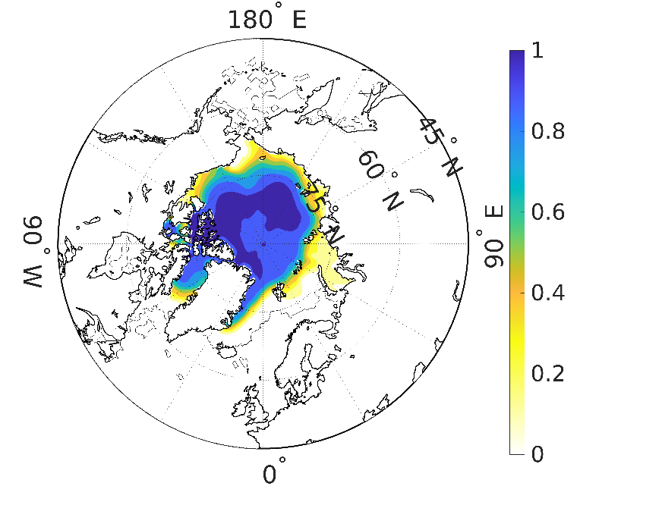
4.1. Reduction of the ice volume and its area
(a) (b)
Figure 2. The averaged over the years 90-100 ice thickness in meters (a), and ice compactness (b)
in September resulted from the base experiment B0.

Slide 29
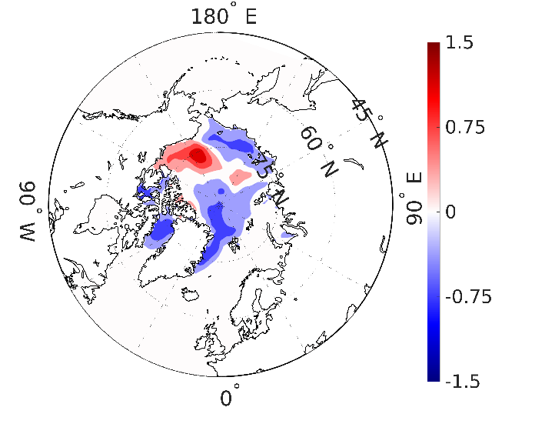
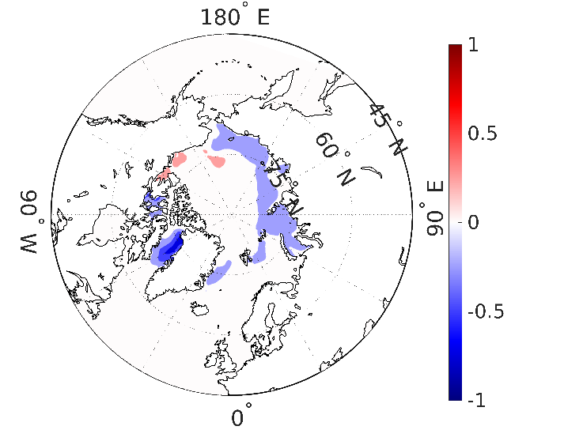
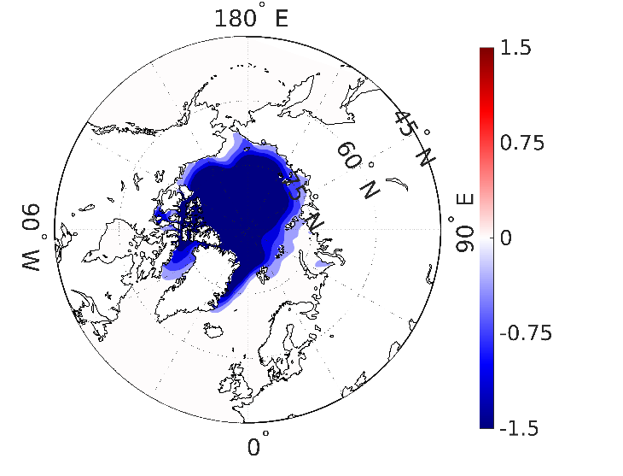
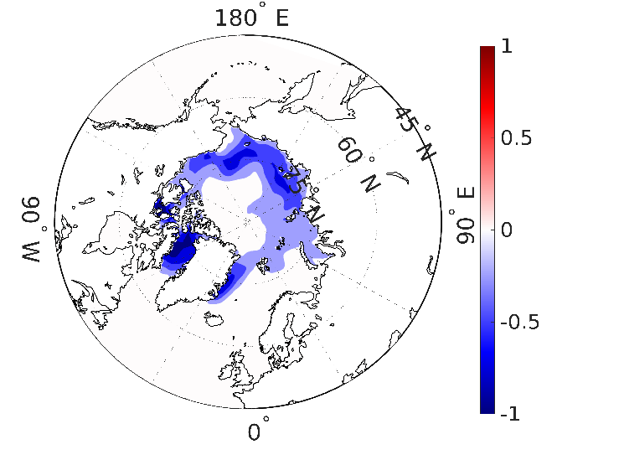
difference of the
A1 and B0
(a) (b)
difference of the
A2 and B0
(c) (d)
Figure 3. The averaged over the years 90-100 ice thickness in meters (a,c), and ice compactness (b,d): (a), (a,b) – the difference of the A1 and B0; (c,d) – the difference of the A2 and B0;

Slide 30
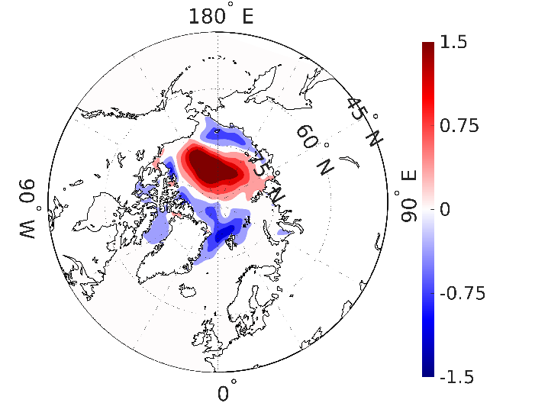
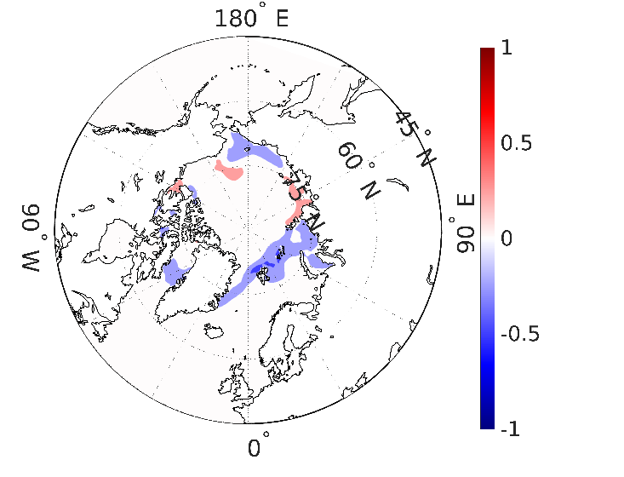
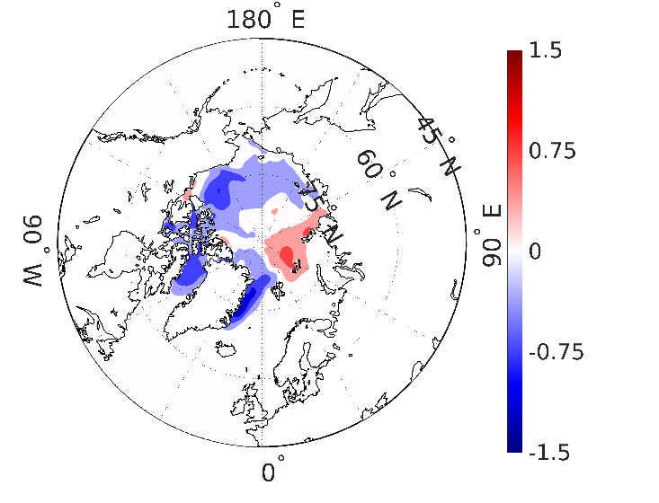
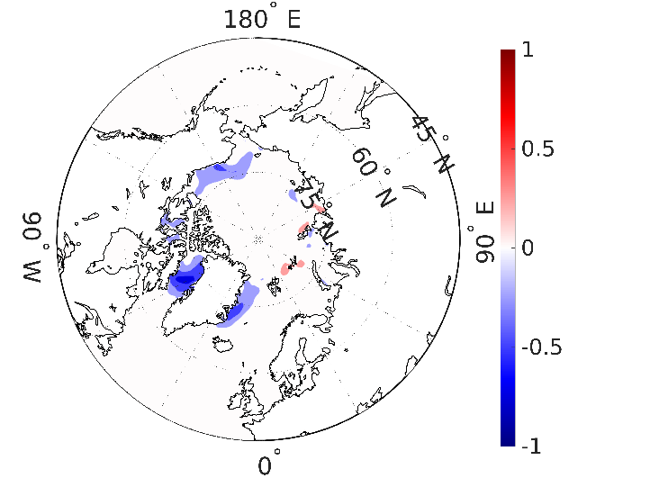
difference of
the C1 and B0
(e) (f)
difference of
the C2 and B0
(g) (h)
Figure 4. The averaged over the years 90-100 ice thickness in meters (e,g), and ice compactness
(f,h): (e,f) – the difference of the C1 and B0; (g,h) – the difference of the C2 and B0;

Slide 31
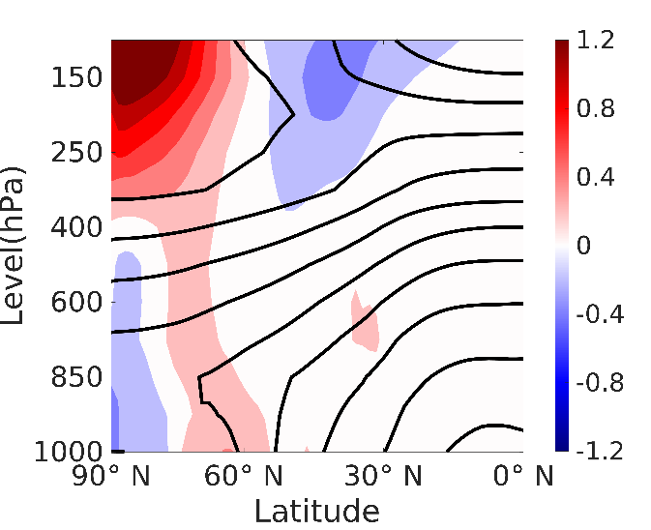
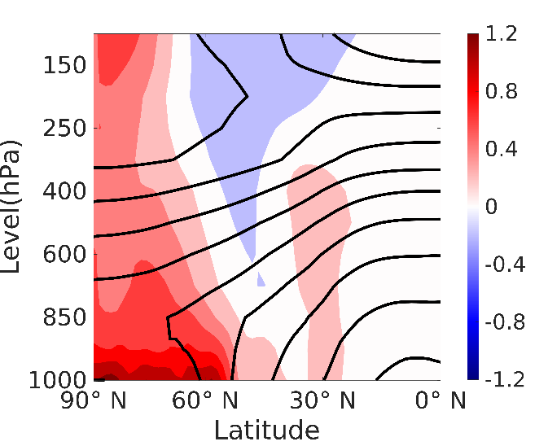
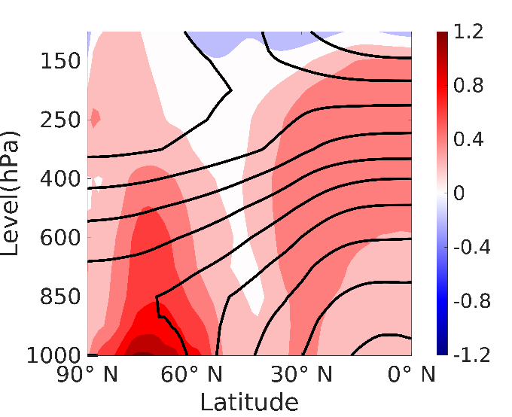
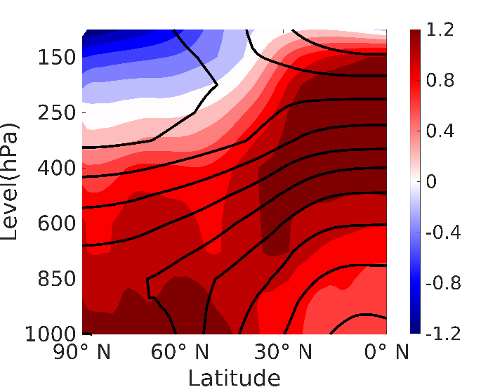
4.2 Anomalies of the zonal distribution potential temperature (DJF)
albedo reduced by
0.03
albedo reduced by
0.1
(a) (b)
CO2 concentration to
450 ppm
CO2 concentration to
600 ppm
(c) (d)
Figure 4. Anomalies of the zonal distribution of potential temperature resulted from averaging the winter (December-January-February) months over the last 30-year period (years 71-100). The isolines show the zonal distribution in the B0 experiment. Color shading highlights the deviations in the A1 experiment with an albedo reduced by 0.03 (a) and 0.1 in the A2 experiment (b), in the C1 experiment with an increase in CO2 concentration to 450 ppm (c) and in the C2 experiment with 600 ppm (d).

Slide 32
4.3. Wave activity and blockings
We can introduce two components of LWA corresponding to φe and for each λ according to
Local wave activity (LWA) is a natural generalization of finite-amplitude wave activity regarding a specific range of longitudes (Huang and Nakamura, 2016)

Slide 33
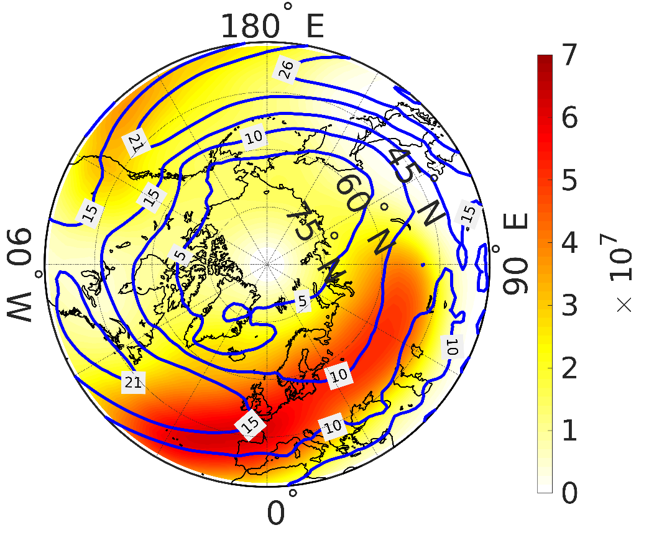
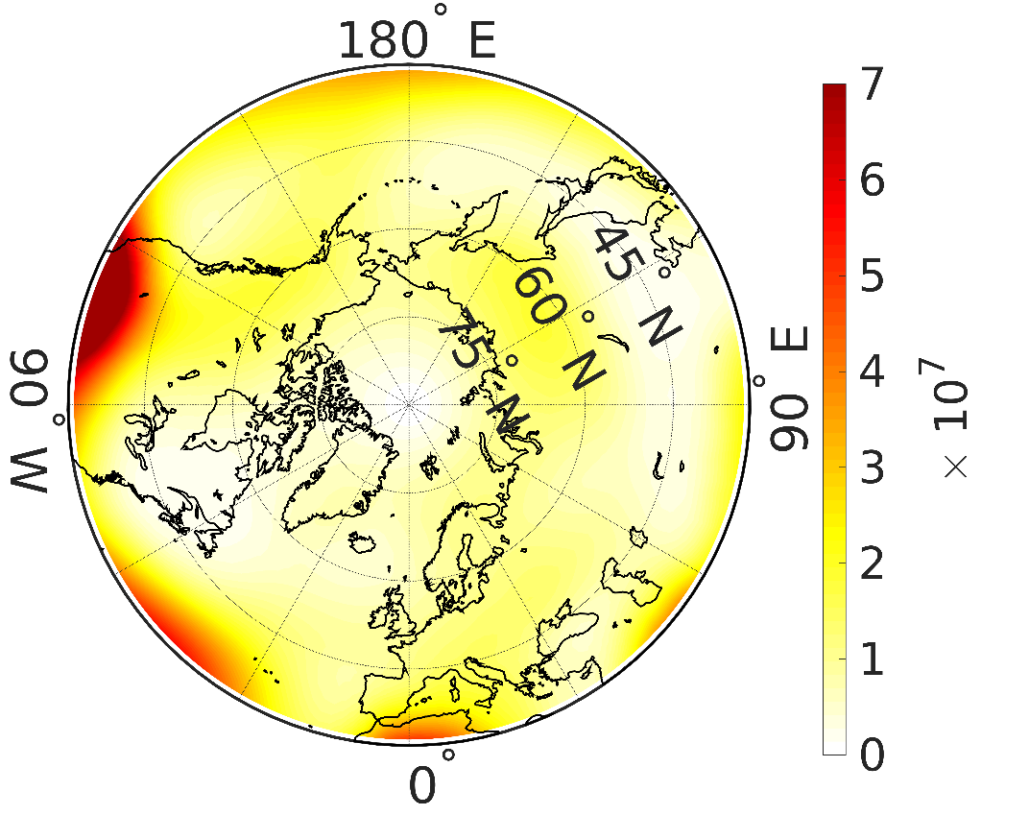
(a) (b)
Figure 7. The averaged over the years 90-100 LWA distributions for winter (December-January-February) with contours of wind speed U (a) and summer (June-July-August) (b) resulted from the base experiment B0.

Slide 34
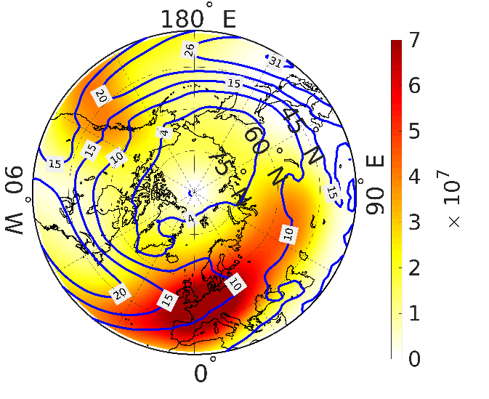
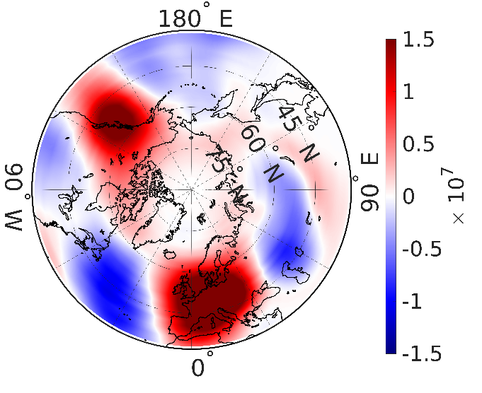
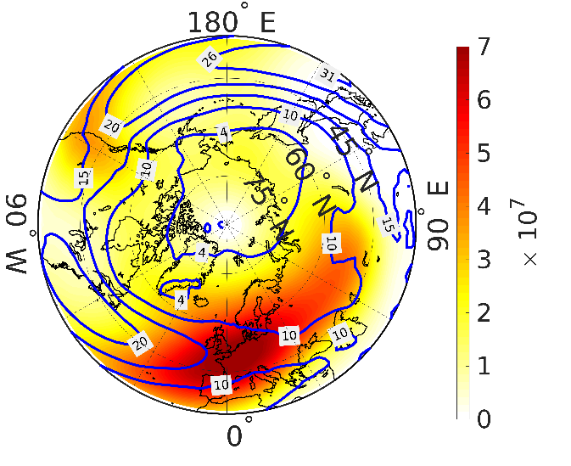
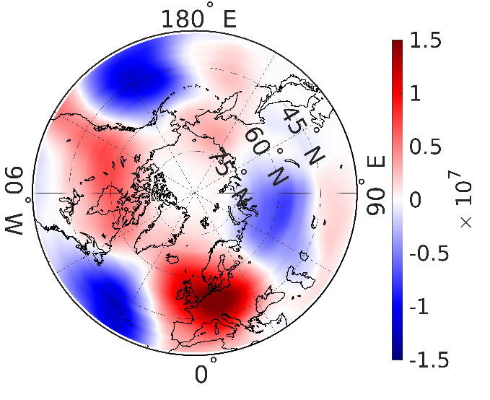
(a) (b)
(c) (d)
Figure 8. The averaged over the years 90-100 LWA winter distribution (December-January- February) with countours of wind speed U: (a), (b) – A1 and its difference with B0; (c), (d) – A2 and its difference with B0;

Slide 35
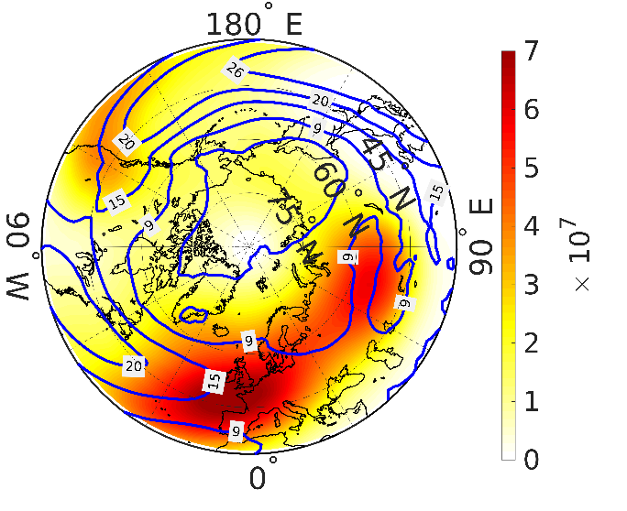
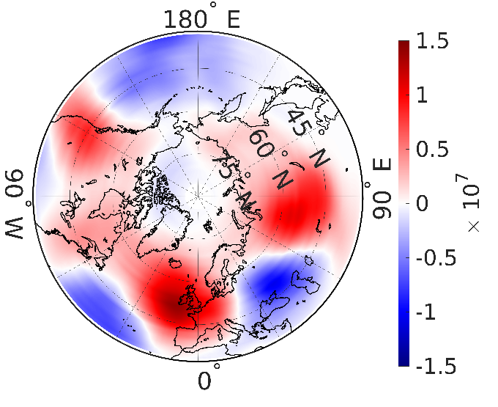
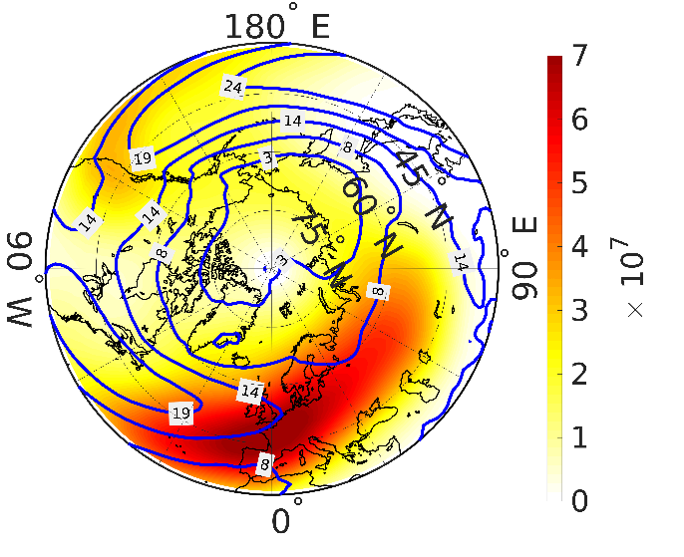
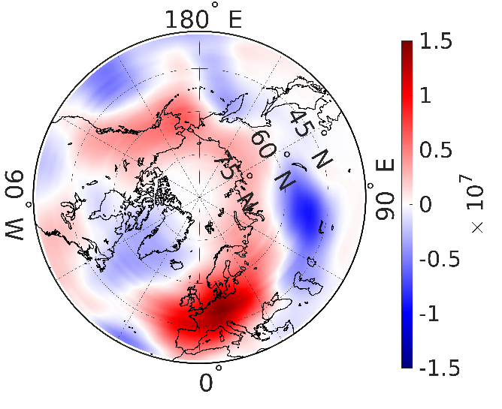
(e) (f)
(g) (h)
As in Figure 8, but for (e), (f) – C1 and its difference with B0; (g), (h) – C2 and its difference with B0.

Slide 36
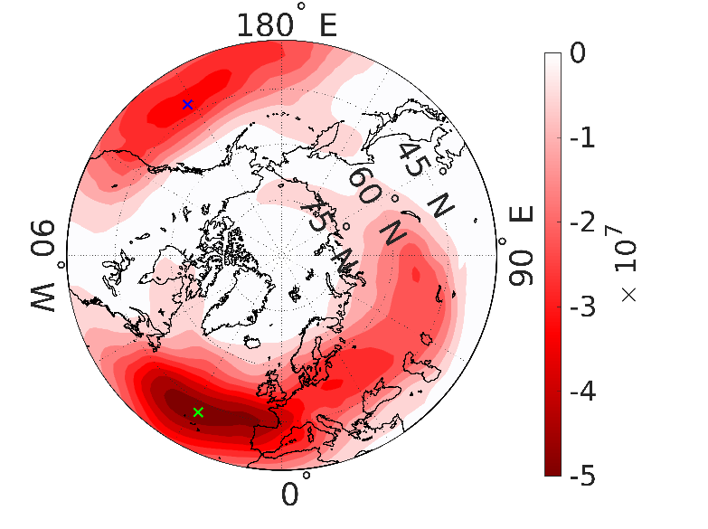
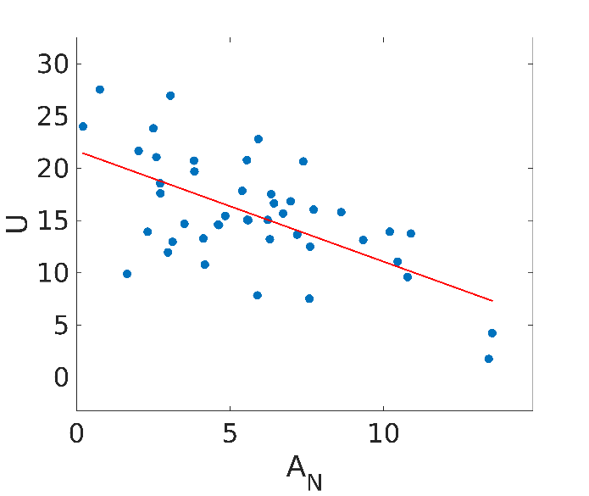
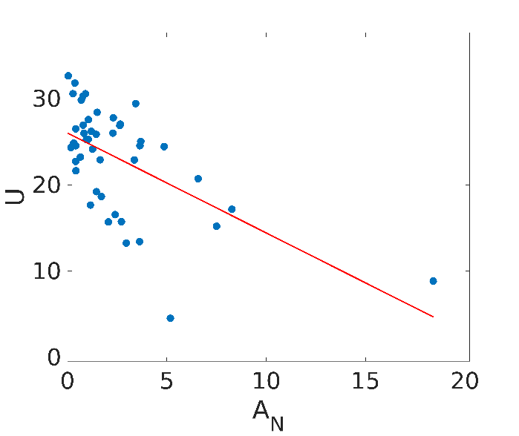
(a) (b) (c)
Figure 9. Covariation and scatter diagram of the average winter (December-January-February) values of AN (m2) and U (m/s) for the years 85-100 of B0 modeling; (a) – covariation coefficient distribution with maximally negative values in Atlantic and Pacific oceans labelled by cross-sign, (b) – Scatter diagram in Atlantic extremal point, and (c) – Scatter diagram in Pacific extremal point. The red straight line is constructed by the least squares method for all events.

Slide 37
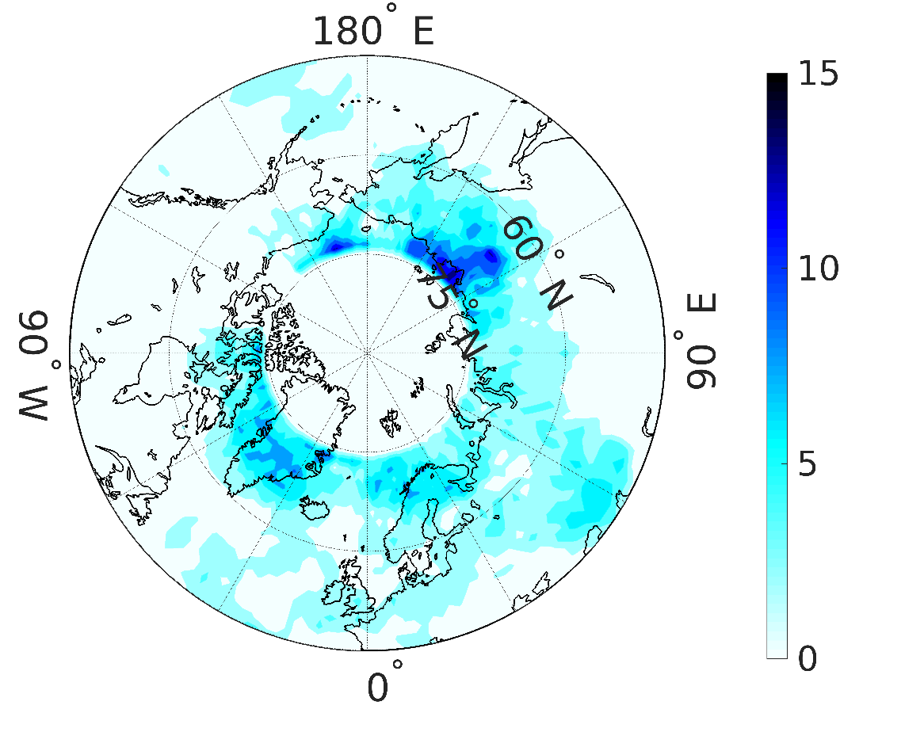
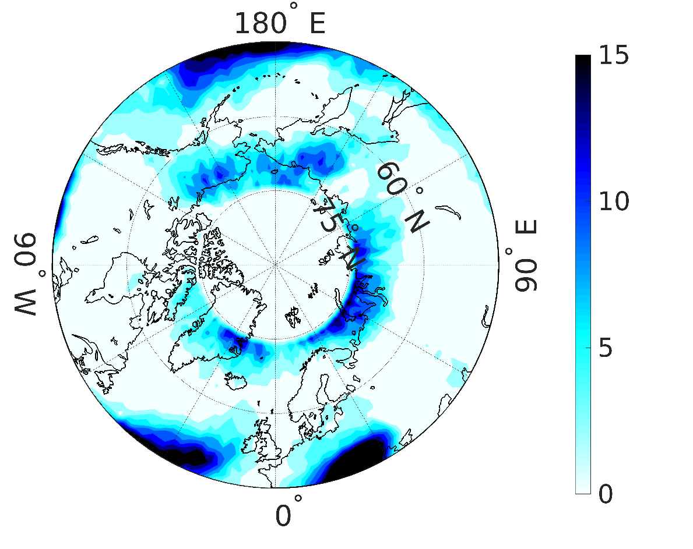
(a) (b)
Figure 10. Climatology of blocking frequency in winter (December-January-February) (a) and in
summer (June-July-August) (b) resulted from the B0 experiment averaged over the years 90-100.

Slide 38
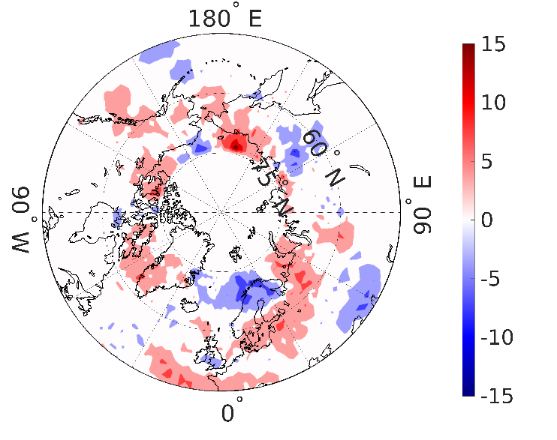
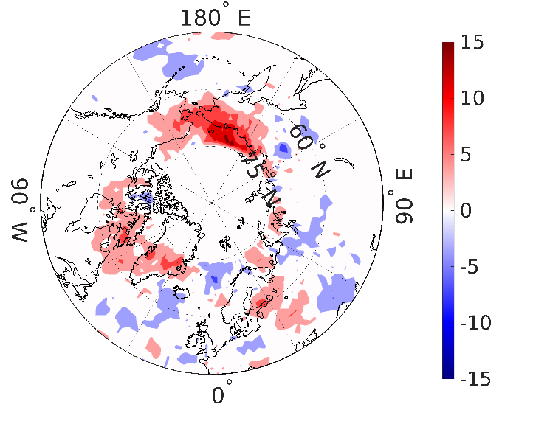
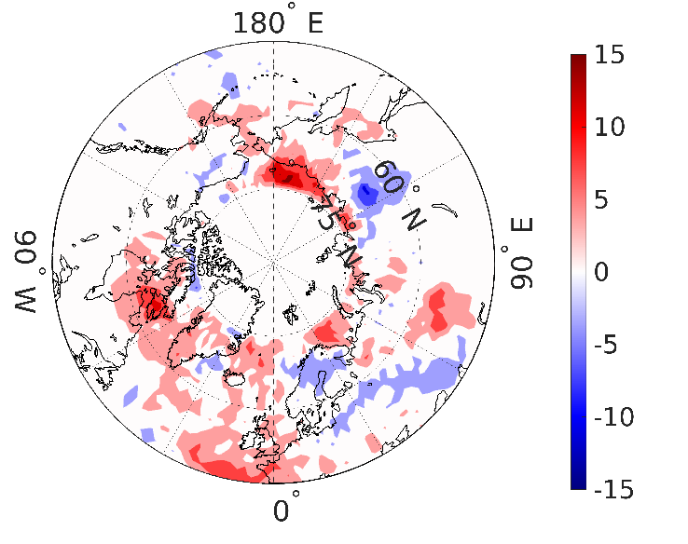
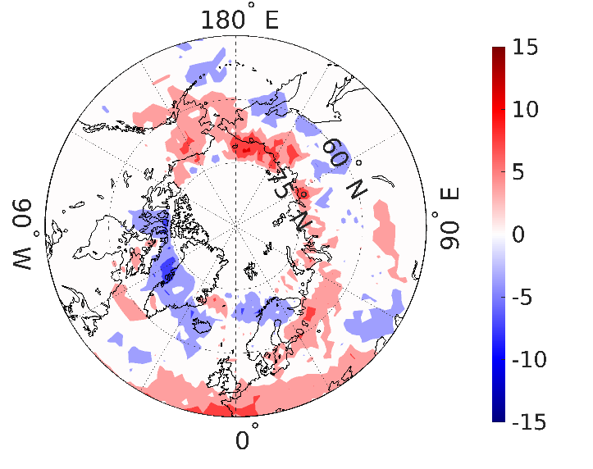
(a) (b)
(c) (d)
Figure 11. Climatology trends of blocking frequency in winter (December-January-February): (a) – difference between A1 and B0, (b) – difference between A2 and B0, (c) – difference between C1 and B0, (d) – difference between C2 and B0 averaged over the years 90-100.

Slide 39
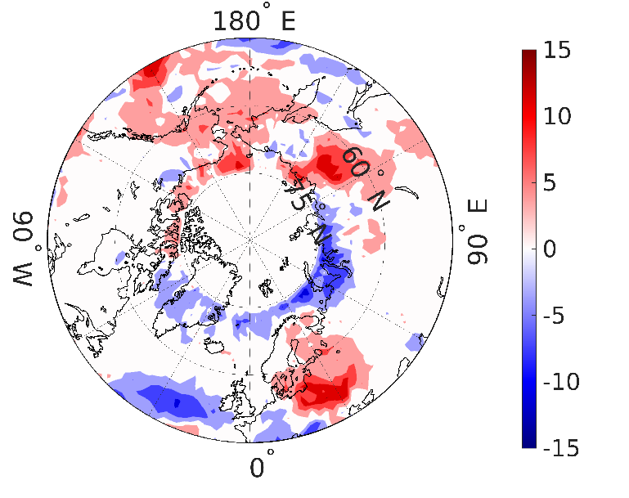
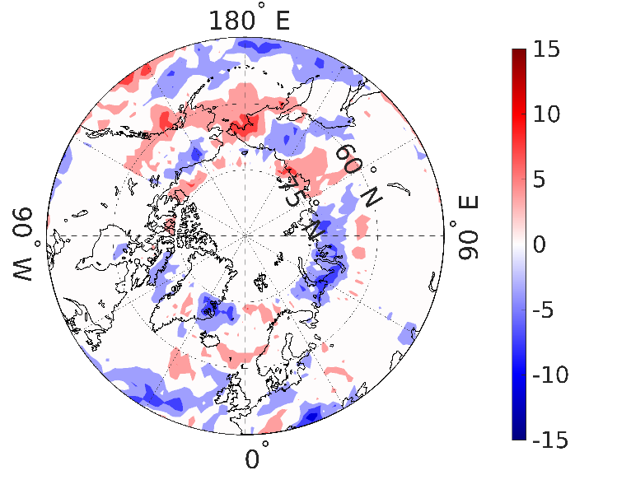
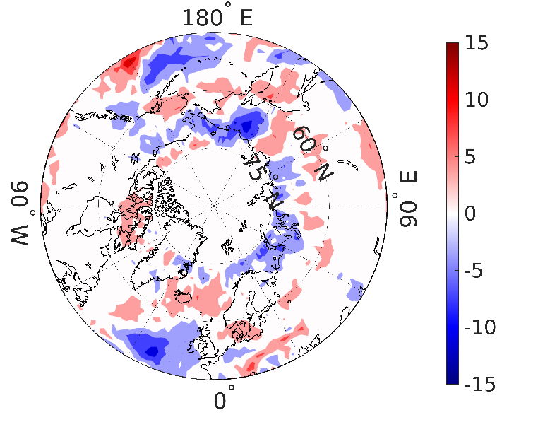
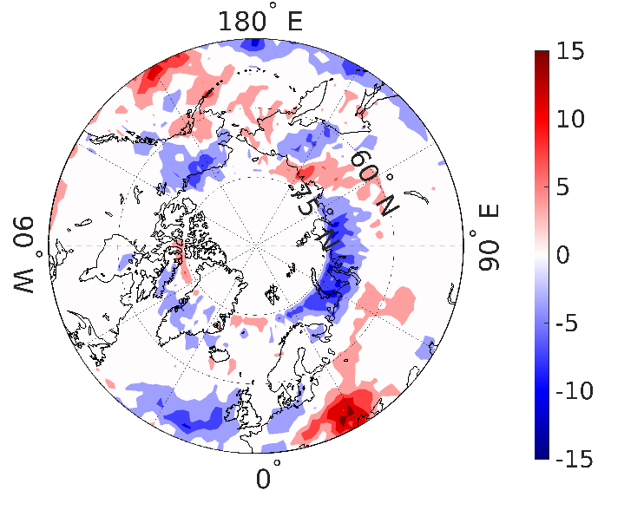
Figure 12. Climatology trends of blocking frequency in summer (June-July-August): (a) – difference between A1 and B0, (b) – difference between A2 and B0, (c) – difference between C1 and B0, (d) – difference between C2 and B0 averaged over the years 90-100.

Slide 40
5. Conclusions
We used two mechanisms of ice reduction: an increase in the concentration of carbon dioxide in the atmosphere and a reduction in the reflectivity of ice and snow.
The most prominent consequences of ice reduction, as a result of numerical tests, were the weakening of temperature gradient at the tropopause level in mid-latitudes, the zonal wind speed decrease near 50-60 N and its increase in the subtropics, intensification of wave activity in Europe, Western America, and Chukotka, and its weakening in the south of Siberia and Kazakhstan. Changes in wave activity lead to changes in the frequency and intensity of blockings.
We used a modified blocking criterium to evaluate the simulated blocking frequency and blocking intensity for north hemisphere mid-latitude regions in winter and summer, corresponding to ice reduction.
We can identify the following general tendencies associated with winter blockings: their weakening in the vicinity of the British Isles and Kazakhstan, with a simultaneous increase in northern Europe and the Urals; weakening in the east of the Aleutian Islands and strengthening in the region of Alaska and the Sea of Okhotsk. The summer trends include weakening in areas close to the subtropics, weakening along the Barents-Kara- Laptev Seas, strengthening in the Bering and Chukchi Seas. Also, blockings strengthen in Eastern Europe, but extreme ice loss makes this strengthening insignificant

Slide 41
Thank you much for your attention

